Slide 1
NLP

Slide 2
Introduction to NLP
Machine Translation

Slide 3
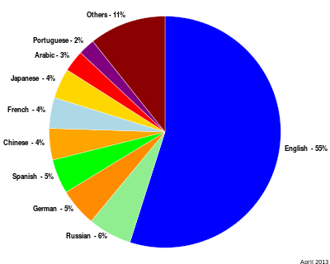
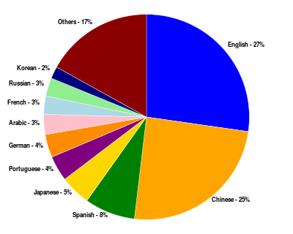
Multilingual Users
Content languages for websites Percentage of Internet users by language
http://en.wikipedia.org/wiki/Global_Internet_usage

Slide 4
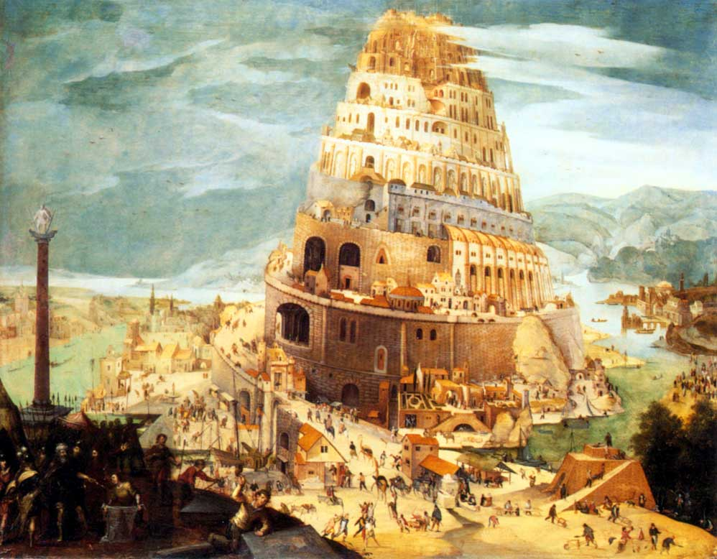
Genesis 11:1-9
[The Tower of Babel, by Pieter Bruegel the Elder, 1563]

Slide 5
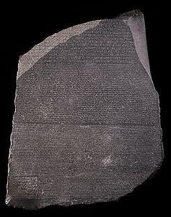
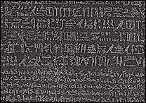
The Rosetta Stone
Carved in 196 BC in Egypt
Deciphered by Champollion in 1822
Mixture of Egyptian (hieroglyphs and Demotic) and Greek
http://www.ancientegypt.co.uk/writing/rosetta.html

Slide 6
English-Cebuano Bible Example
In the beginning God created the heaven and the earth.
Sa sinugdan gibuhat sa Dios ang mga langit ug ang yuta.
And God called the firmament Heaven.
Ug gihinganlan sa Dios ang hawan nga Langit.
And God called the dry land Earth
Ug ang mamala nga dapit gihinganlan sa Dios nga Yuta
use: co-occurrence, word order, cognates
corpora are needed
sentence alignment needs to be done first
http://en.wikipedia.org/wiki/Bible_translations_by_language

Slide 7
NACLO Problem
http://nacloweb.org/resources/problems/2012/N2012-C.pdf
http://nacloweb.org/resources/problems/2012/N2012-CS.pdf
Problem by Simon Zwarts, based on work by Kevin Knight
www.nacloweb.org

Slide 8
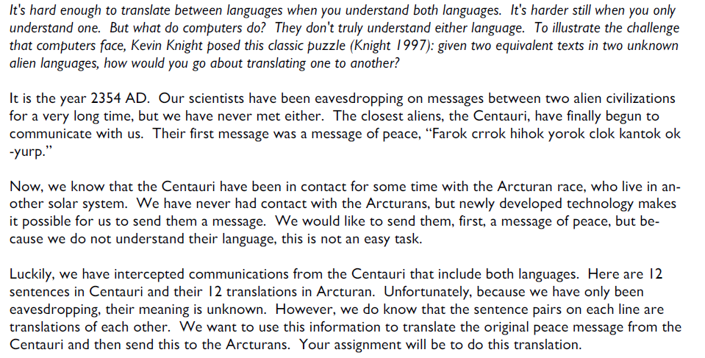
Arcturan Problem – 1/4

Slide 9
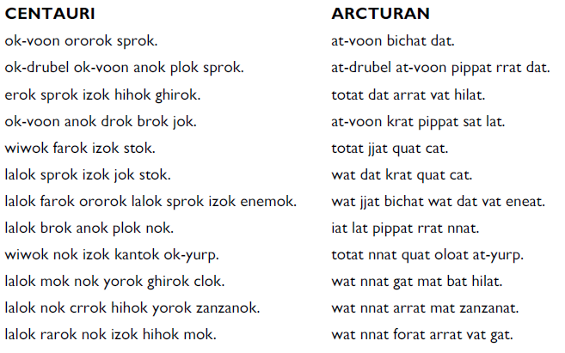
Arcturan Problem – 2/4

Slide 10
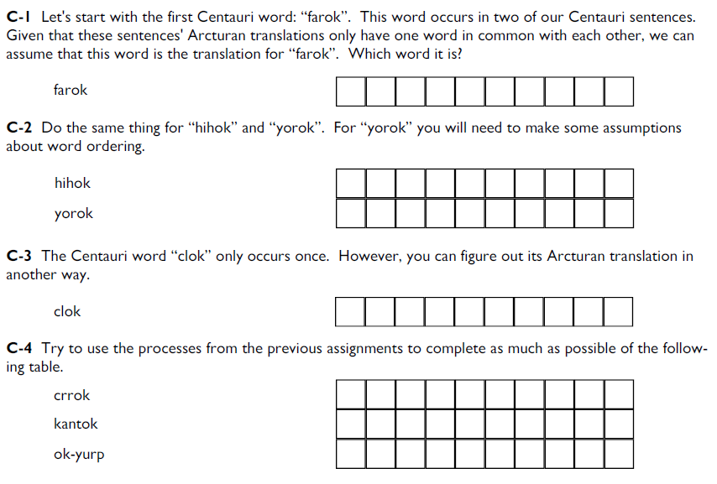
Arcturan Problem – 3/4

Slide 11
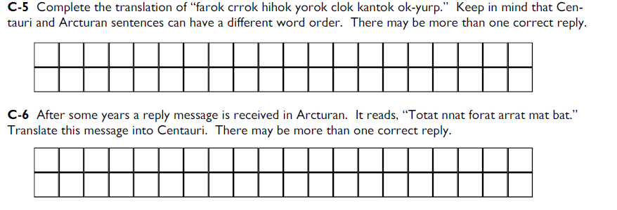
Arcturan Problem – 4/4

Slide 12
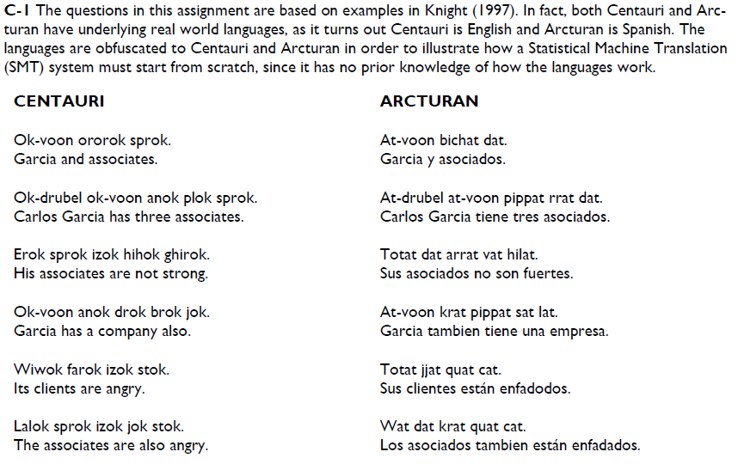
Arcturan Solution – 1/3

Slide 13
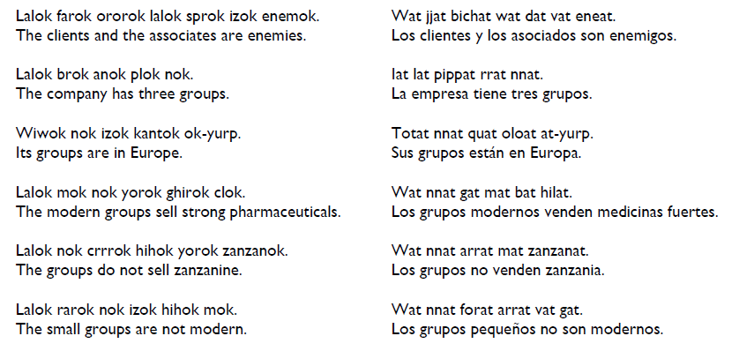
Arcturan Solution – 2/3

Slide 14
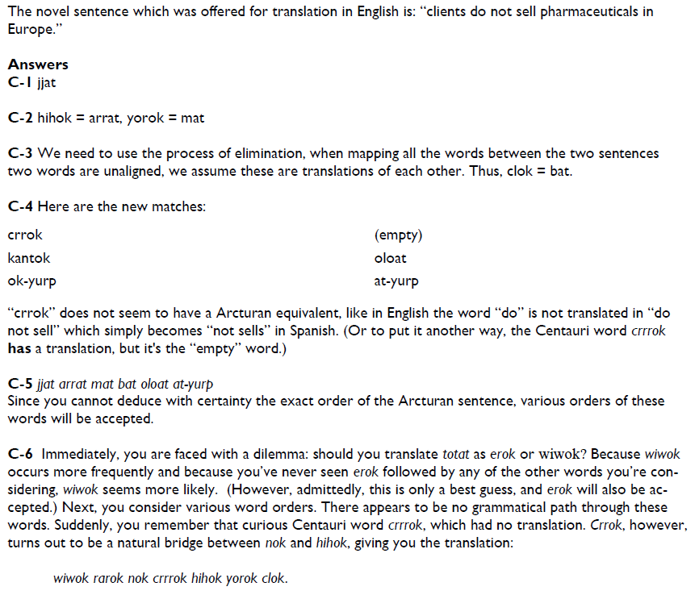
Arcturan Solution – 3/3

Slide 15
Parallel Corpora
The Rosetta Stone
The Hansards Corpus
The Bible
Europarl

Slide 16
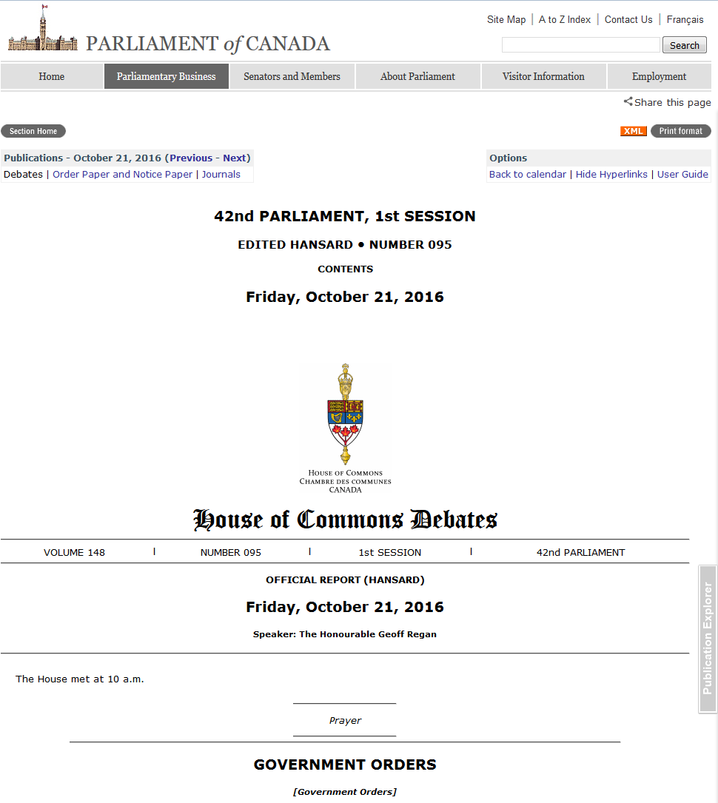

Slide 17
Hansards Example
English
<s id=960001> I would like the government and the Postmaster General to agree that we place the union and the Postmaster General under trusteeship so that we can look at his books and records, including those of his management people and all the memos he has received from them, some of which must have shocked him rigid.
<s id=960002> If the minister would like to propose that, I for one would be prepared to support him.
French
<s id=960001> Je voudrais que le gouvernement et le ministre des Postes conviennent de placer le syndicat et le ministre des Postes sous tutelle afin que nous puissions examiner ses livres et ses dossiers, y compris ceux de ses collaborateurs, et tous les mémoires qu'il a reçus d'eux, dont certains l'ont sidéré.
<s id=960002> Si le ministre voulait proposer cela, je serais pour ma part disposé à l'appuyer.

Slide 18
Language Differences (1/6)
[Example from Jurafsky and Martin]

Slide 19
Language Differences (2/6)
Word order in phrases (Fr.)
la maison bleue, the blue house
Word order in sentences (Jap.)
I like to drink coffee
watashi wa kohii o nomu no ga suki desu
I-subj coffee-obj drink-dat-rheme like
vocabulary (Sp.)
wall
pared, muro
phrases (Fr.)
play
pièce de théâtre

Slide 20
Language Differences (3/6)
Prepositions (Jap.)
to Mariko, Mariko-ni
Inflection (Sp.)
have: tengo, tienes, tenemos, tienen, tener
Lexical distinctions (Sp.):
the bottle floated out - la botella salió flotando
Brother (Jap.)
otooto (younger), oniisan (older)
They (Fr.)
elles (feminine), ils (masculine)

Slide 21
Language Differences (4/6)
Das Vorhaben verwarf die Kommission
The plan rejected the commission
OSV reading is more plausible
I saw the movie and it is good
How do we translate “it”?
[Examples from Philipp Koehn]

Slide 22
Language Differences (5/6)
Color Names
Russian:
light blue (голубой, goluboy)
dark blue (синий, siniy)
Japanese:
青 (ao) – both blue and green historically
緑 (midori) – recent addition

Slide 23
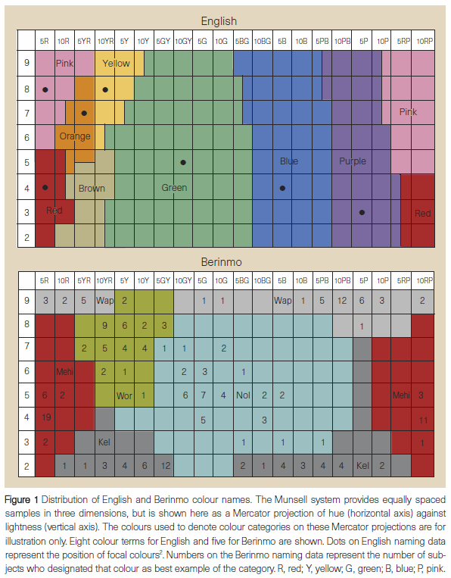
Language Differences (6/6)
Davidoff et al. 99

Slide 24
NLP

